Slide 1



Multi-omics Boot Camp
Analysis of Omics Data for Research Studies
Bringing it All Together: Multi-omic Analysis in Real Data
Jesse Goodrich, PhD
University of Southern California
jagoodri@usc.edu
David Conti
Hongxu Wang
Qiran Jia

Slide 2
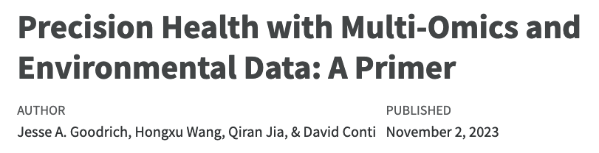


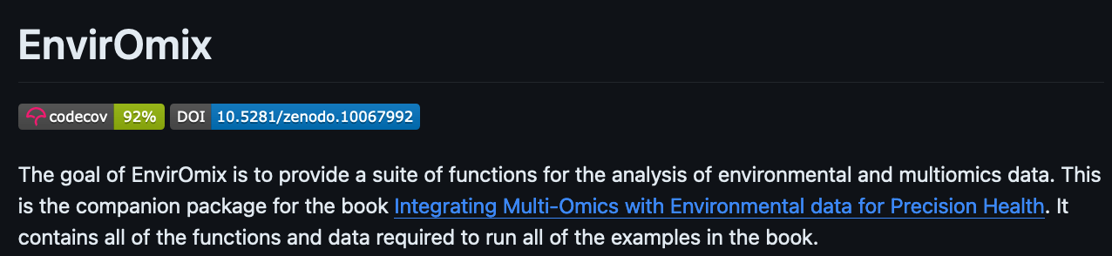

Resources
Goodrich JA, Wang H, et al. Integrating Multi-Omics with Environmental Data for Precision Health: A Novel Analytic Framework and Case Study on Prenatal Mercury Induced Childhood Fatty Liver Disease. Preprint at SSRN.
Or: https://github.com/Goodrich-Lab

Slide 3
Overview
Goal: Illustrate multi-omics data analysis approaches applied to real data.
Background:
Data: HELIX data
Exposure: Maternal Mercury Exposure
Outcome: Liver Injury
Omics: 5 omics layers
Analysis: Examine whether multi-omics signatures mediate associations of prenatal mercury exposure and childhood liver injury using:
High dimensional mediation without dimensionality reduction
Mediation with dimensionality reduction/clustering
Quasi-mediation

Slide 4
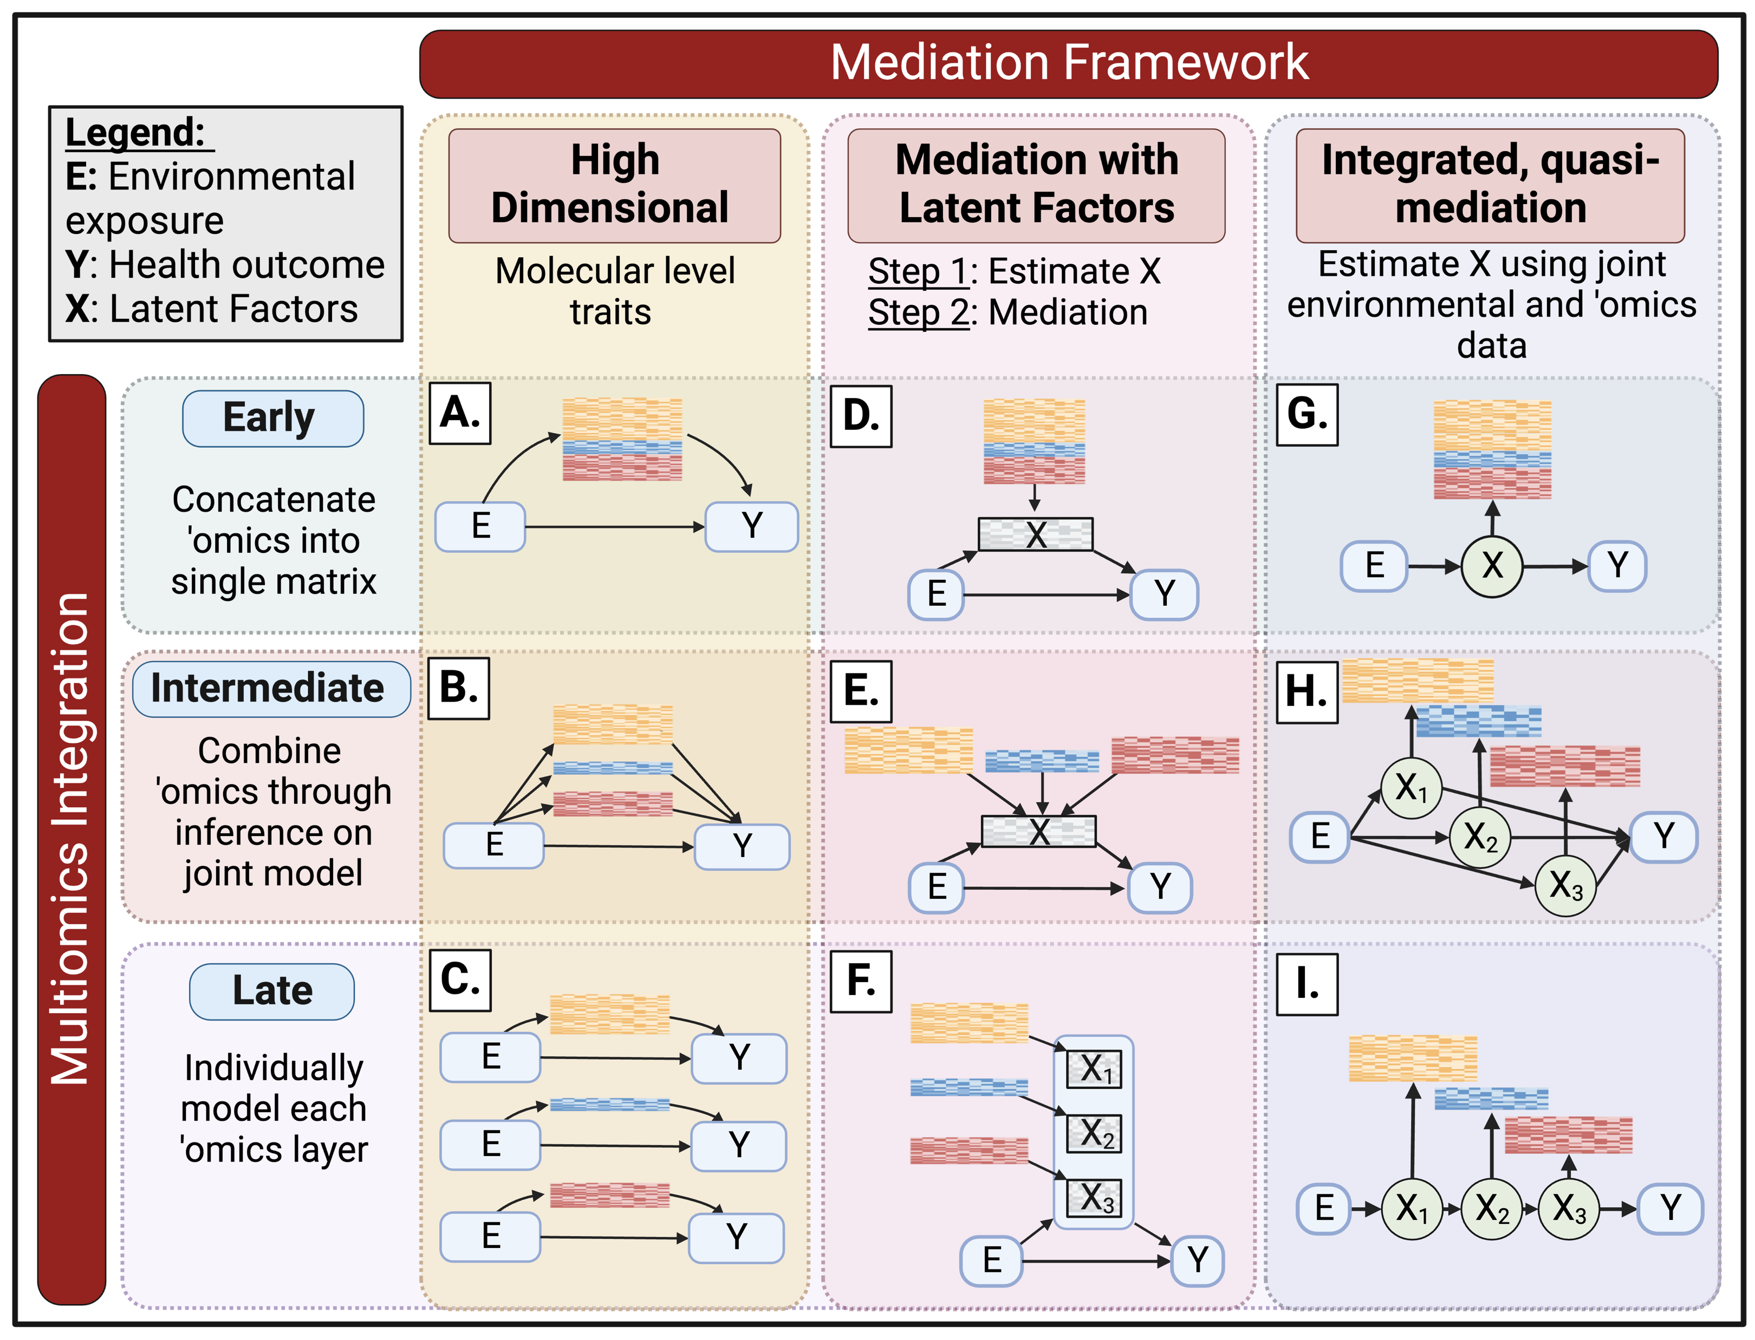
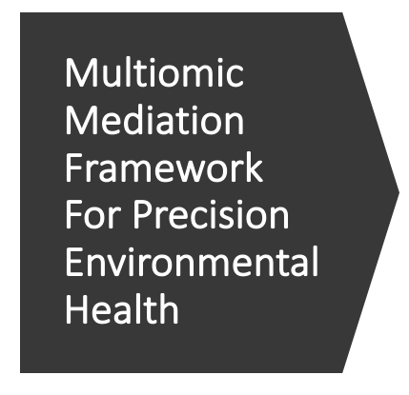
Multiomic Mediation Framework For Precision Environmental Health

Slide 5
Multiomic Mediation Framework For Precision Environmental Health

Slide 6
Multiomic Mediation Framework For Precision Environmental Health

Slide 7
Multiomic Mediation Framework For Precision Environmental Health

Slide 8
Multiomic Mediation Framework For Precision Environmental Health

Slide 9
Application Of Framework: A Case Study On Prenatal Mercury Exposure And Childhood Liver Injury

Slide 10
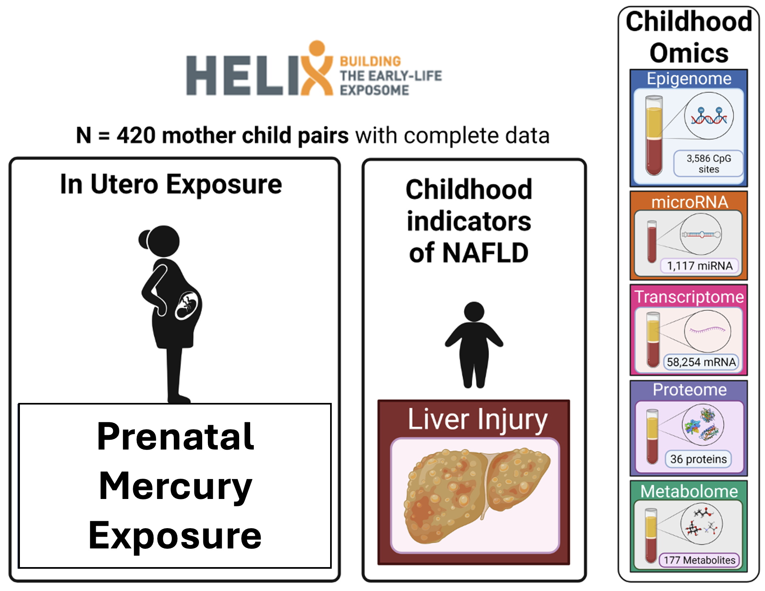

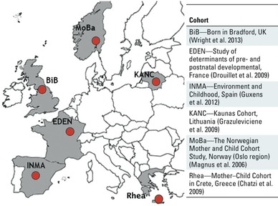
THE HUMAN EARLY LIFE EXPOSOME (HELIX) COHORT
Maitre et al, BMJ Open, 2018

Slide 11
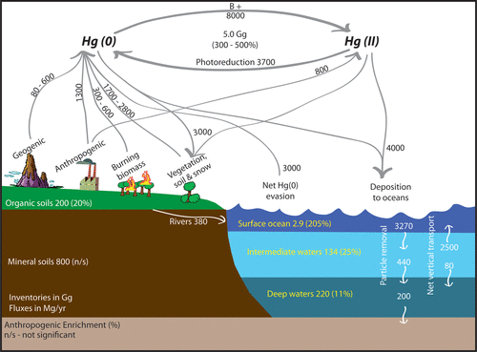
Where is mercury found? How are we exposed?
Mercury compounds are in soils, sediments, and groundwater
Occur naturally or from industrial processes
Exposure is primarily through contaminated water and food
Has several adverse health effects
Driscoll et al., Environ Sci Technol, 2023
Sunderland et al., J Expos Sci & Epidemiol, 2019

Slide 12
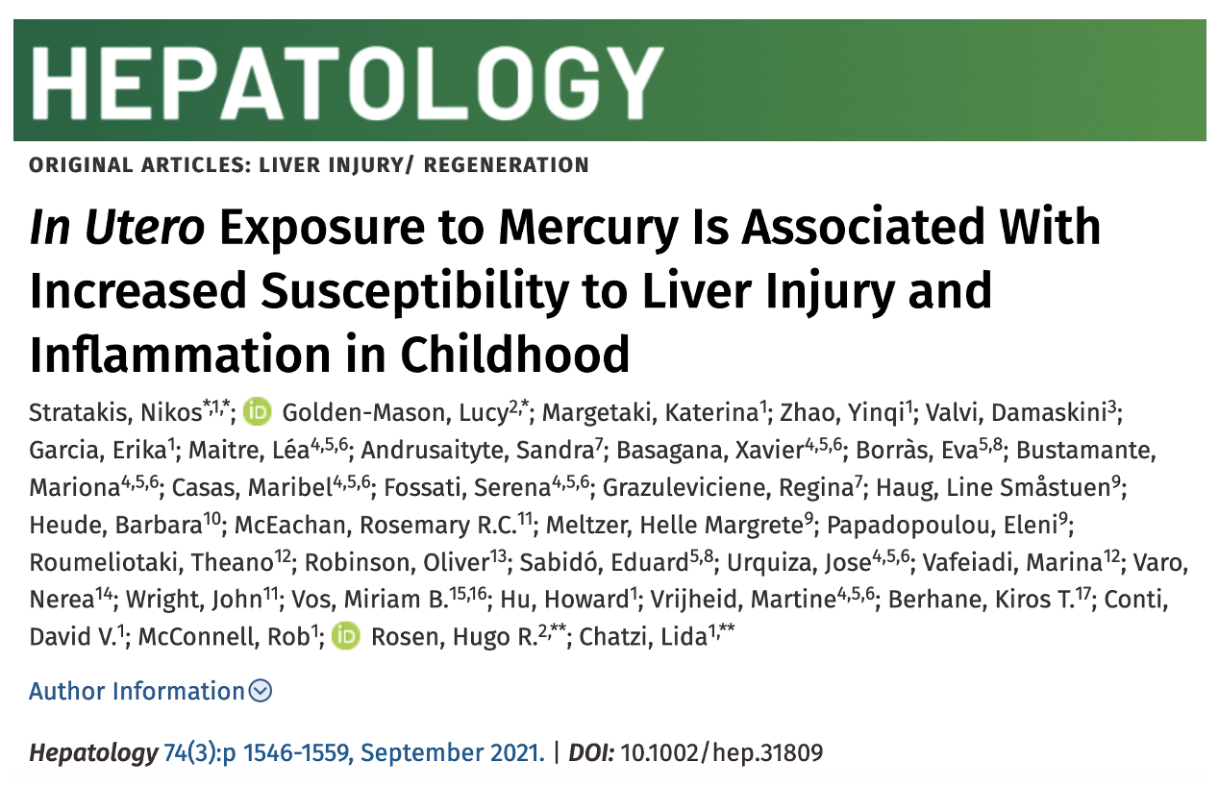
In HELIX: Prenatal mercury exposure linked to childhood liver injury
Each standard deviation (SD) increase in prenatal mercury was associated with a 0.11 [95% CI: 0.01, 0.21] SD increase in CK-18 (p=0.02).
Associations significant after adjusting for child sex, child age, HELIX cohort, and prenatal fish intake

Slide 13
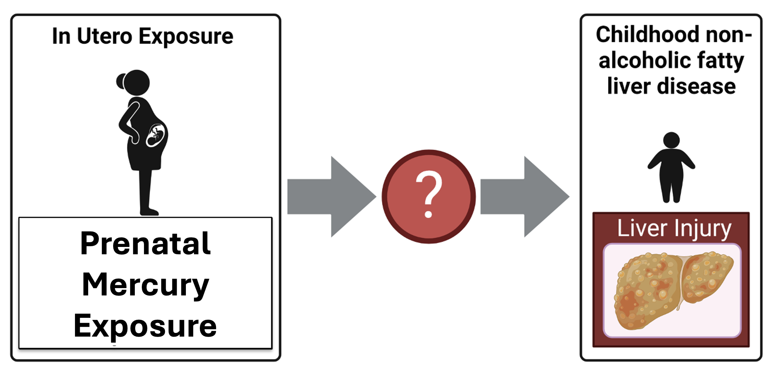
However, the mechanisms are not clear

Slide 14
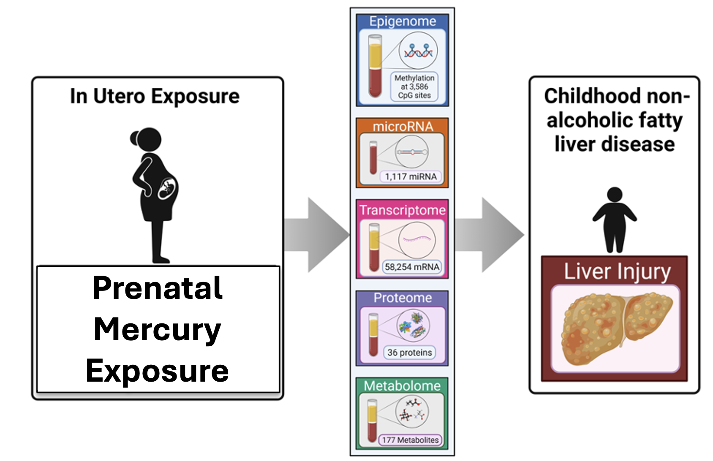
Goal: Integrate multi-omics data to understand mechanisms linking prenatal mercury & liver injury

Slide 15
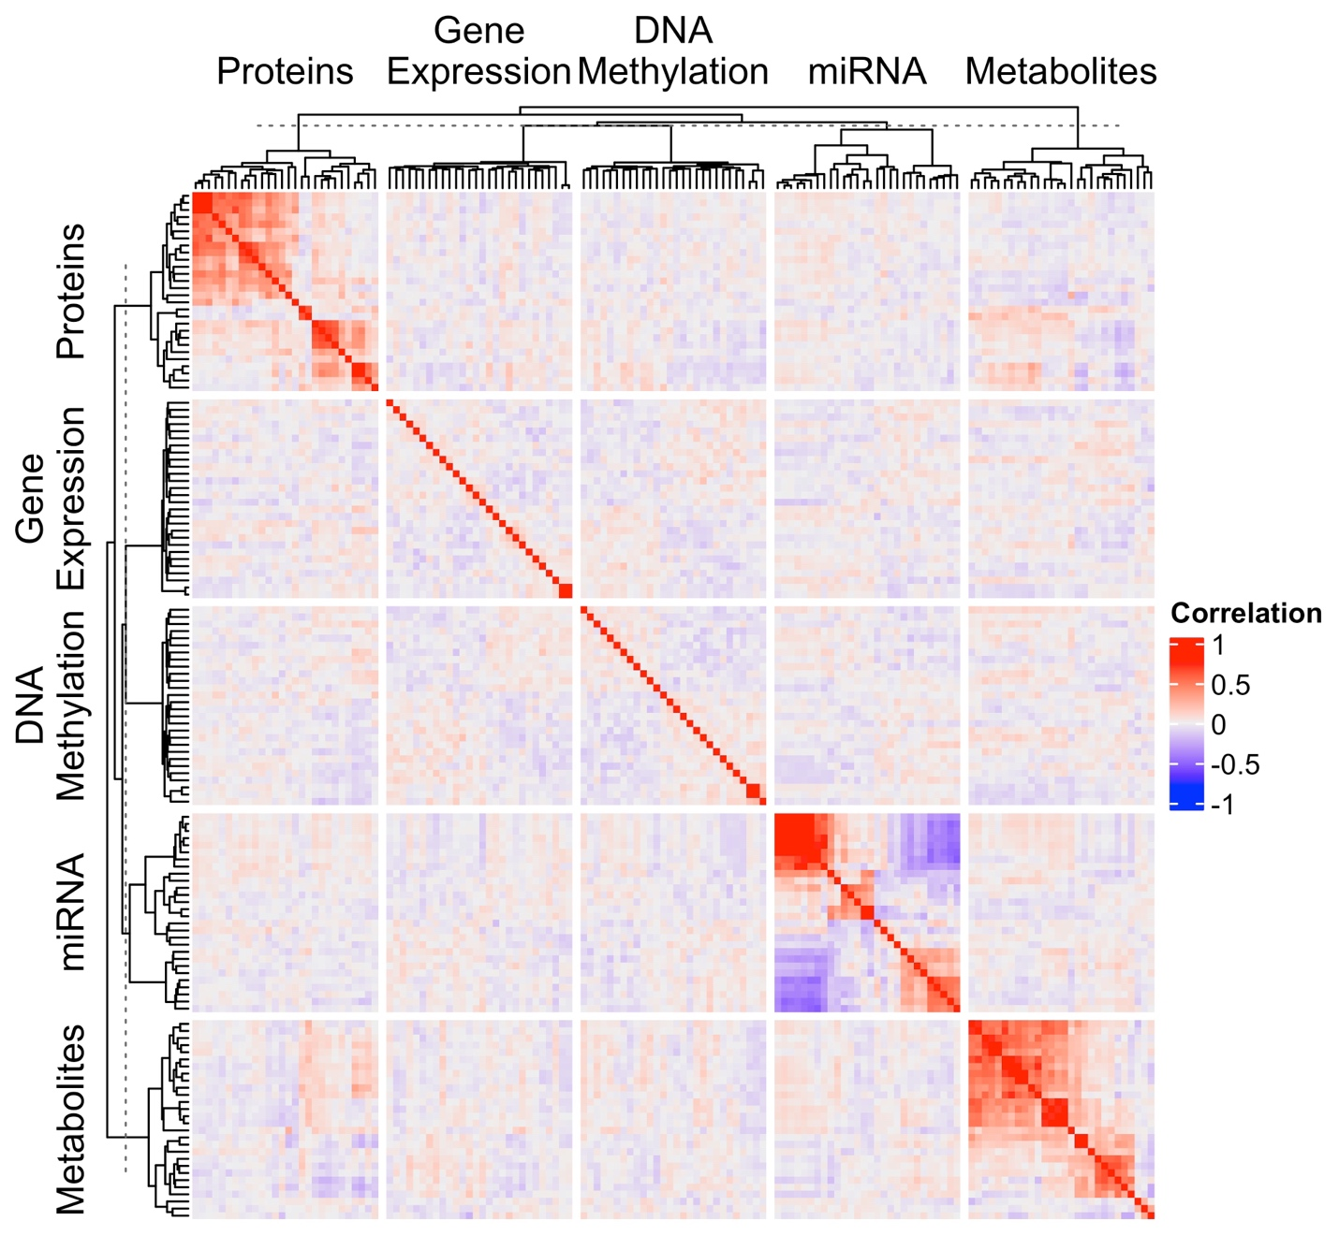
Importance of using multiomic methods in this data
Notes:
it’s crucial to use dedicated multiomics methods for these types of analyses because:
Different Correlation Structures: Each omics layer has unique correlation structures due to the different biological mechanisms they represent. For instance, transcriptomic data may reflect gene co-expression networks and proteomic data shows protein-protein interactions. Multiomics methods incorporate these correlation structures into their models, thus enabling more accurate integration and interpretation of the data.
Heterogeneity and Noise: Each omics layer is subject to different sources and levels of noise and heterogeneity, related to both technical variability (e.g., measurement error, batch effects) and biological variability (e.g., individual differences, tissue-specific expression). Dedicated multiomics methods can account for these differences, for example, through normalization techniques, the use of control samples, or statistical methods to model variability.
Biological Interpretability: Each omics dataset has its unique set of biological annotations (e.g., genomic location, gene function, pathway information). Dedicated multiomics methods can integrate these annotations to facilitate the biological interpretation of the results, leading to more meaningful and actionable insights.
Different Dimensionality: Each omics layer has different dimensionality. Genomic data, for instance, deals with thousands to millions of genetic variants. Transcriptomics data, on the other hand, involves the expression levels of tens of thousands of genes. Metabolomics data may consist of a few hundreds to thousands of metabolite levels. The dimensional differences can cause significant challenges in integrating data, particularly when it comes to aligning, scaling, and comparing across different types of data. Dedicated multiomics methods are designed to handle these challenges by incorporating techniques for dimensionality reduction and normalization across different omics layers.
However, for ease of presenting the results, here I restricted the analysis to only the top features based on a meet-in-the-middle approach for analysis.

Slide 16
Approach 1: High Dimensional Mediation
Environmental Omics Profiles

Slide 17
High Dimensional Mediation Approaches
A: Early Integration.
HIMA with concatenated omics
B. Intermediate integration
Novel group lasso based approach
C. Late Integration
HIMA on omics layers individually

Slide 18
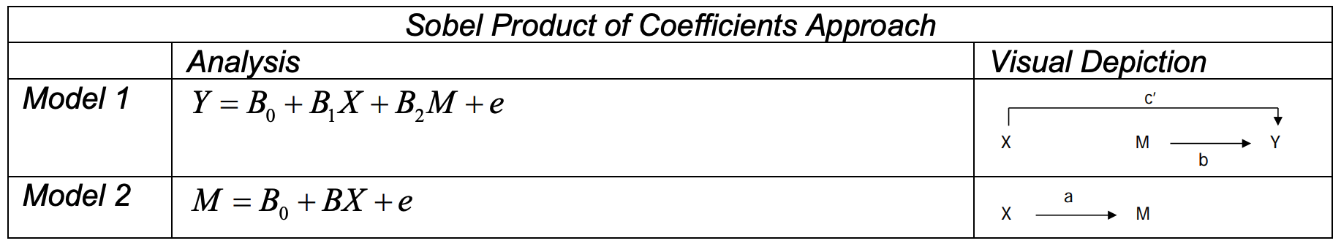
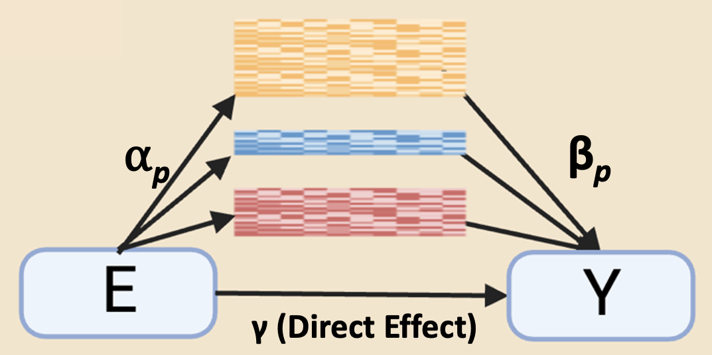
High Dimensional Mediation with Intermediate Integration
Steps:
Model 1: group lasso using xtune with c = 1 (Zeng et al., Bioinformatics, 2021)
Model 2: regular linear regression
Indirect effect and CIs calculated with the product of coefficients method (Williams et al., Structural equation modeling: a multidisciplinary journal, 2008)

Slide 19
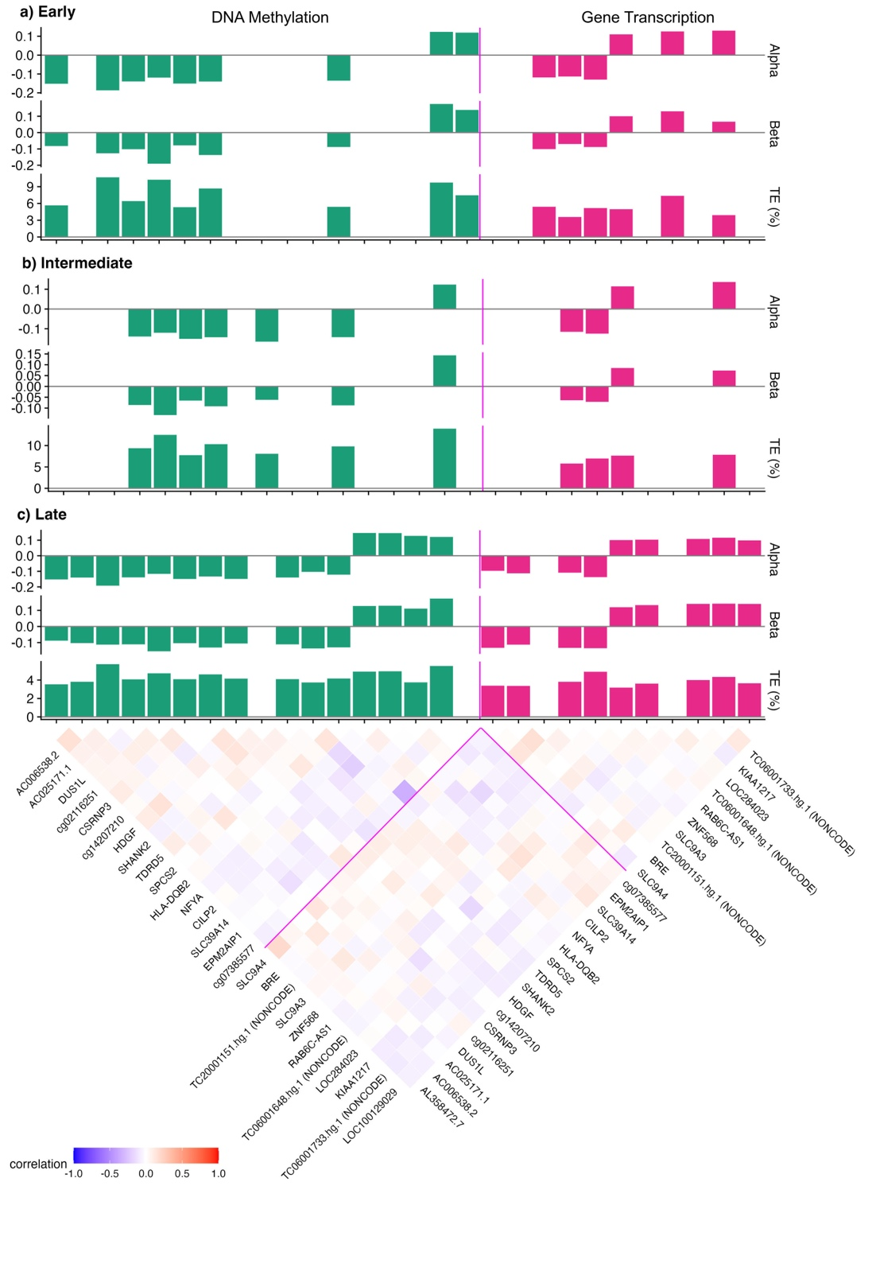
Approach 1: Results

Slide 20
Approach 1: Features exhibit low correlations

Slide 21
Approach 1: Identified CpG sites previously linked to Hg
EPM2AIP1 encodes for Epm2aip1, a protein related to glycogen synthase
Experimental studies: show that EPM2AIP1 gene expression decreases following methylmercury exposure
Animal studies: lower Epm2aip1 increases hepatic lipid accumulation

Slide 22
Summary: High Dimensional Mediation
HIMA with early integration accounts for correlations between all features, and selected features are relatively independent
High dimensional mediation with intermediate integration could be more useful for multiomic integration
HIMA with late integration selects features without accounting for correlation structures across omics layers
Depending on the context, any approach could be useful

Slide 23
Approach 2: Mediation with Latent Factors
Biological Mechanisms

Slide 24

Two Steps: Dimensionality Reduction, then Mediation
Epigenome
miRNA
Transcriptome
Proteome
Metabolome
Dim. Red.
Factors
Hg
Liver Injury
Mediation tested using HIMA*
*Lock et al., The Annals of Applied Statistics, 2013
24
Notes:
In this case, I illustrate dimensionality reduction using PCA or JIVE, a multiblock extension of PCA. JIVE, (Joint and Individual Variation Explained) decomposition on a list of data sets. Returning low-rank matrices that capture the joint and individual structure of the data. The underlying approach is principle components analysis.

Slide 25
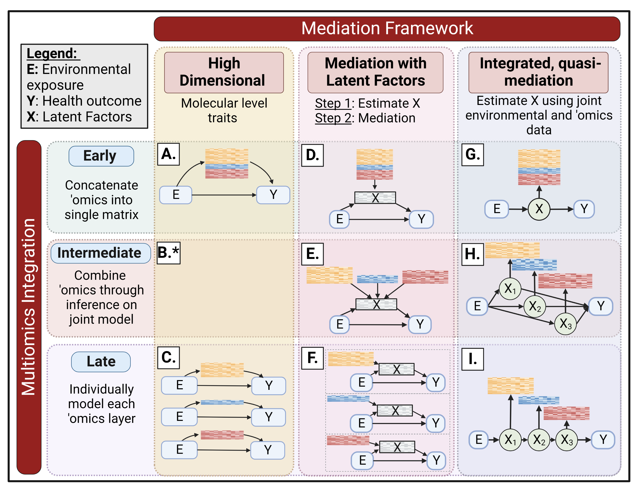
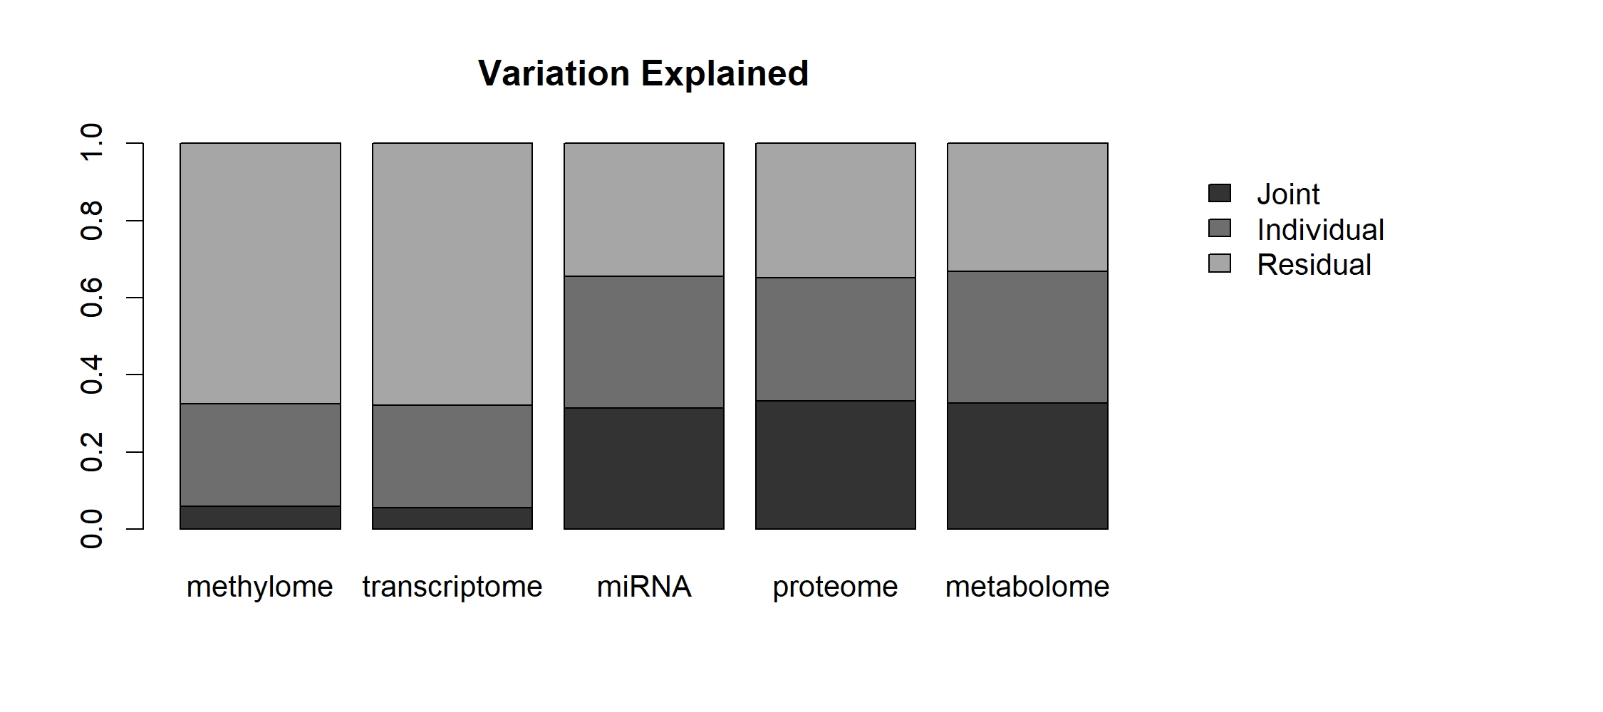
Step 1: JIVE Results
Notes:
So for this analysis, I am really going to focus first on the results of the JIVE output. The other two approaches are just PCA, which is pretty straight forward. But here, you see a plot illustrating the variance explained by each of the low rank matrices (talk through results)

Slide 26
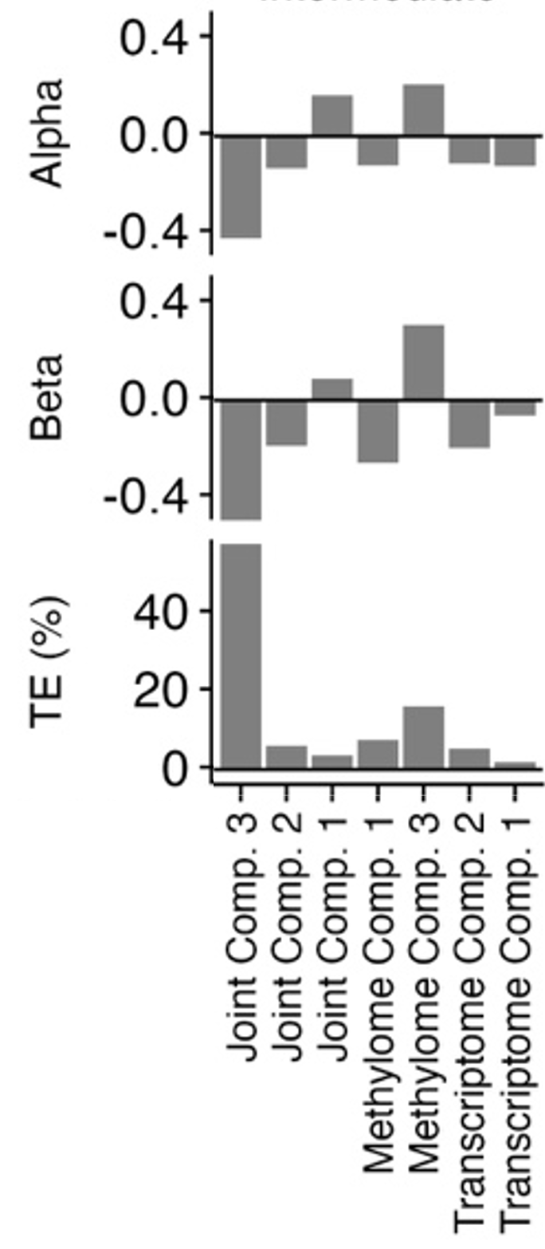
Step 2: Mediation Results
Step 1: JIVE Results
Notes:
So then, we took those low-rank matrices and used those matrices in the mediation analysis using HIMA. Here, you see the results (explain)

Slide 27
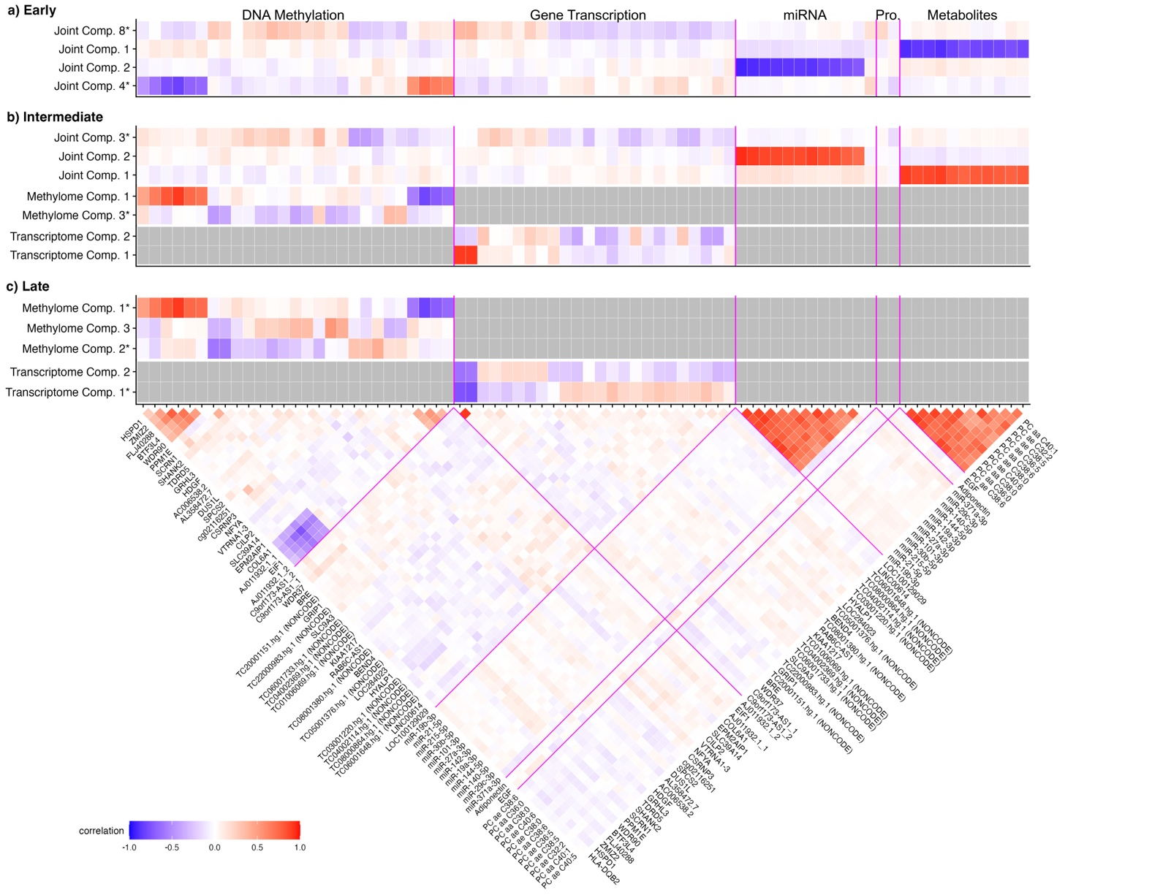
Feature Level Associations- Individual Factors

Slide 28
Feature Level Associations- Joint Factors

Slide 29
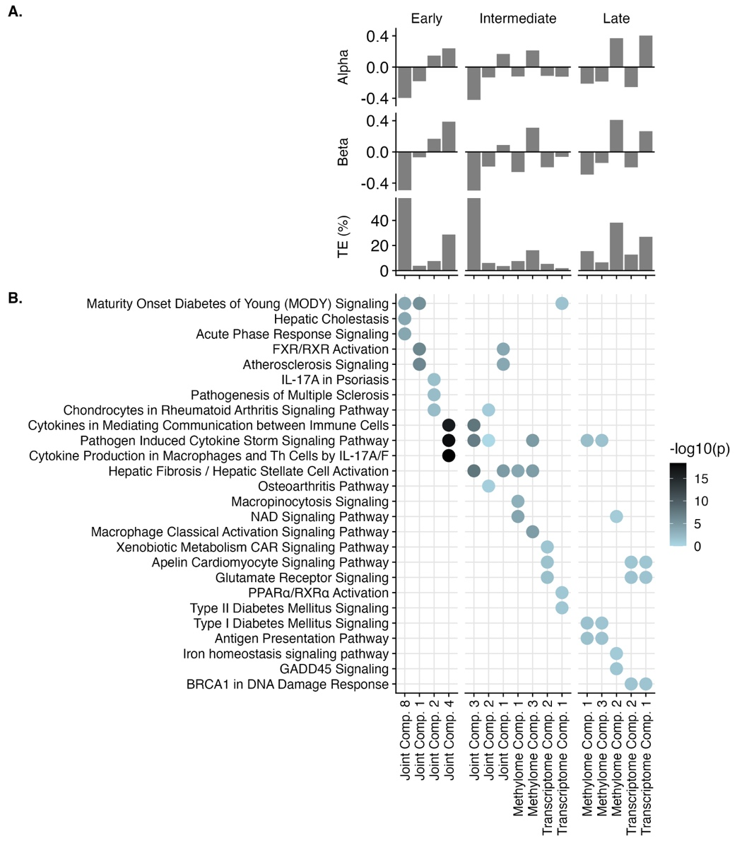
Pathway Analysis: Biological Interpretation
B: Pathway Analysis
A: Mediation Results
Notes:
So this is great, but doesn’t really tell you all that much by itself. So we then looked at which features were driving each of these factors (joint and individual). Click
Explain what this means, (next slides are animations)

Slide 30
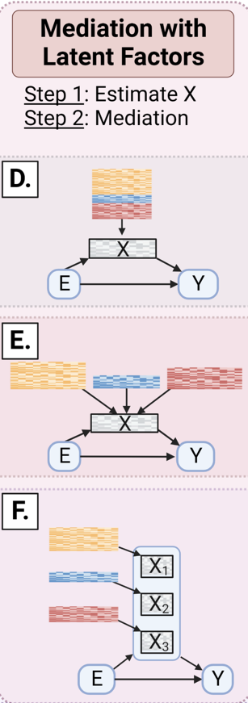
Approach 2: Early Integration

Slide 31
Approach 2: Late
Integration

Slide 32
Approach 2:
All Results
Intermediate mediation identifies a set of joint and individual components that together represent a broader set of biological pathways compared to early or late integration

Slide 33
Dimensionality Reduction Could Also Be Clustering
Epigenome
miRNA
Transcriptome
Proteome
Metabolome
IntNMF
Clusters
PFNA
Liver Injury
Mediation tested using r package mediate
33
Notes:
Joint clustering based on non-negative matrix factorization
Data shifted and rescaled- all data must be greater than 0
integrative non-negative matrix factorization

Slide 34
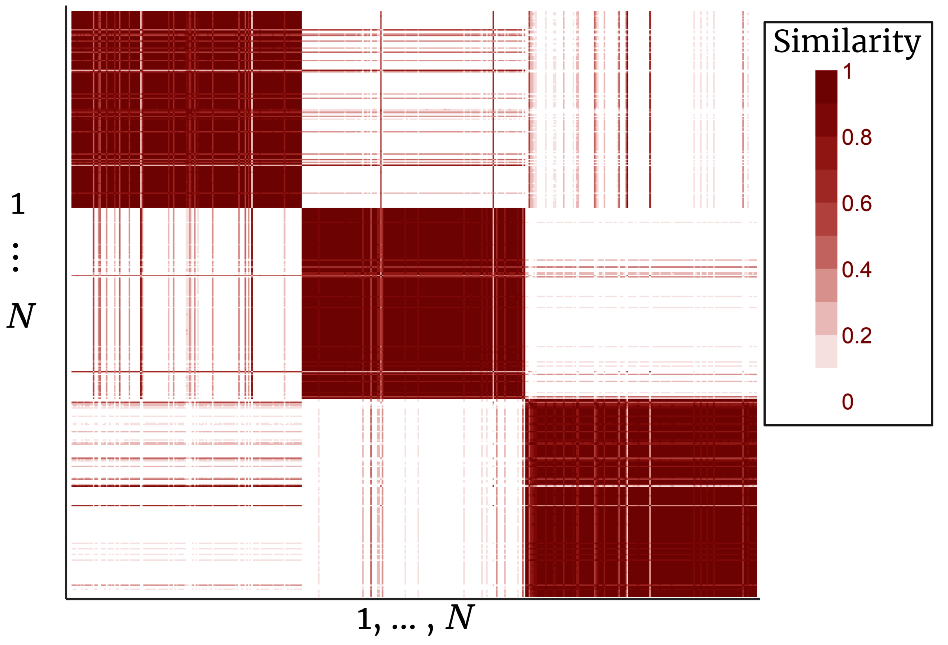
Intermediate Integration, IntNMF: Consensus Matrix
Consensus Matrix of IntNMF Results
Represents similarity between individuals
Three clear clusters
34

Slide 35
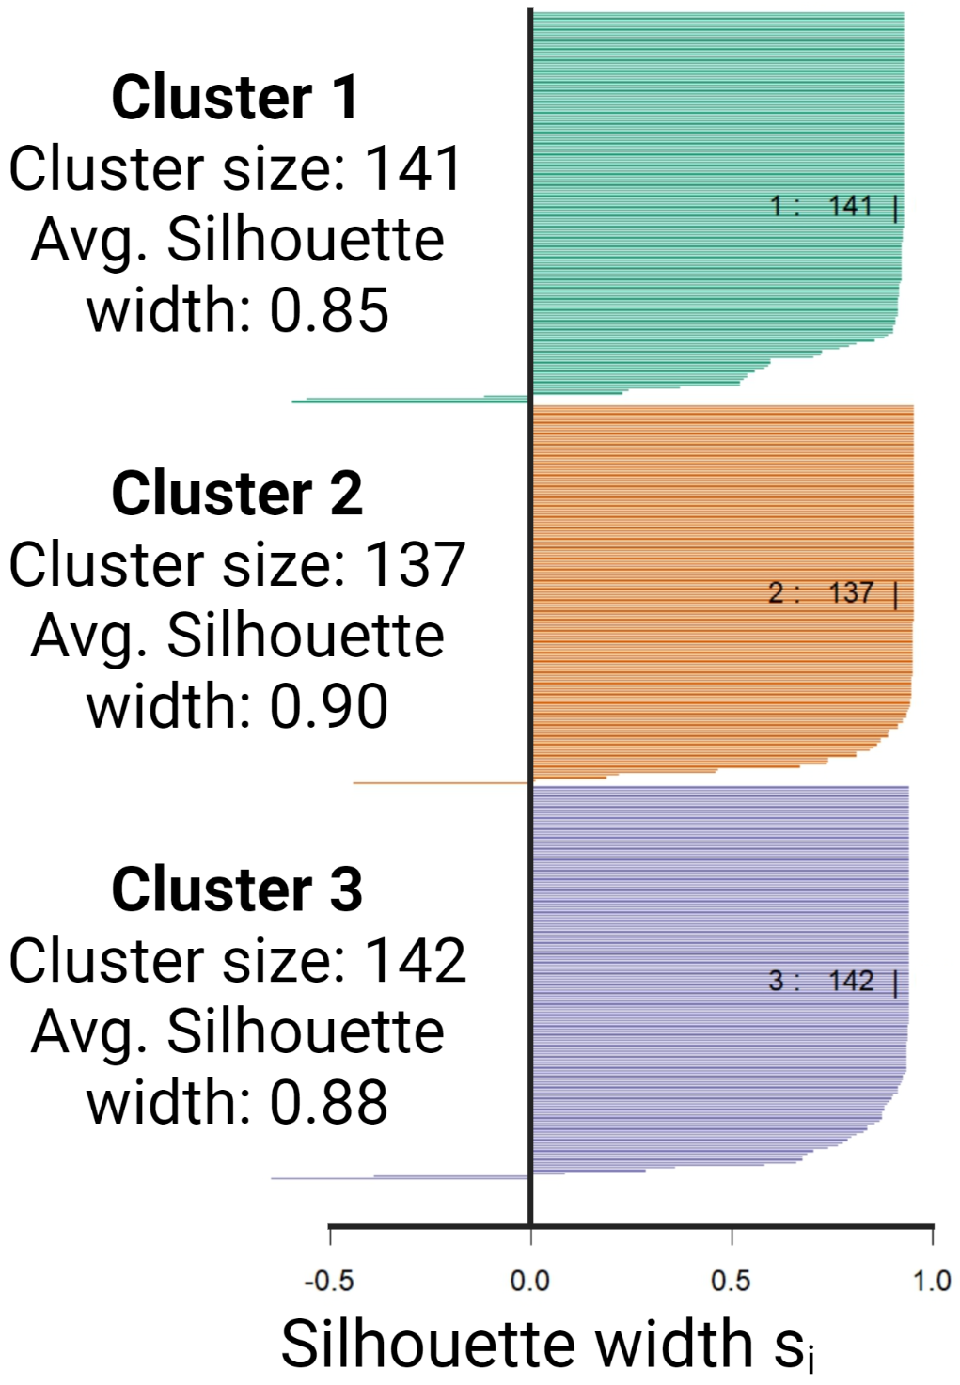
Intermediate Integration, IntNMF: Silhouette Plot
IntNMF performs well at identifying clusters of individuals with similar multi-omic profiles
… but none of these clusters were associated with maternal mercury exposure
35

Slide 36
Approach 3: Integrated/Quasi-mediation
Identifying High Risk Populations

Slide 37
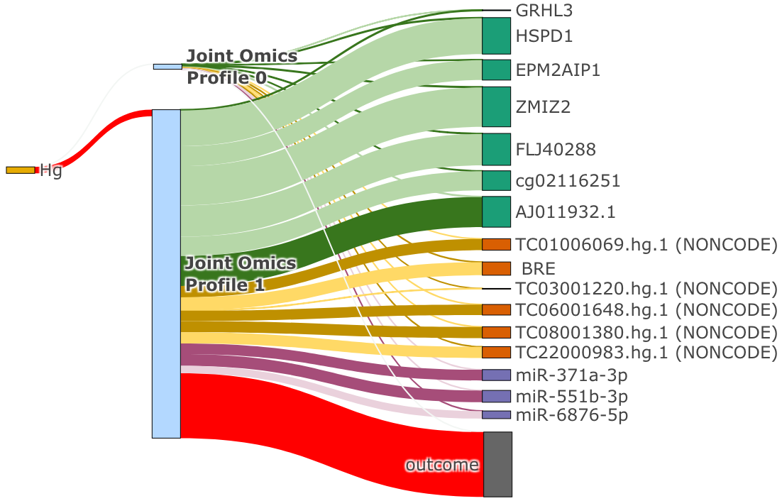
Results: Joint Analysis, Early Integration
Notes:
Here you see the results of lucid with early integration. DESCRIBE FIG- middle shows high risk and low risk clusters.
As you can see, LUCID only selects transcripts and proteins to describe the high-risk clusters. This is partly because it performs feature selection on the omics, and these features are really strongly associated with the outcome in our data.

Slide 38
Joint Analysis, Intermediate Integration
Extension of the previous LUCID model, which includes only a single omics dataset
Models omics in parallel: this approach (as shown in the figure) assumes that omics clusters (X₁, X₂, X₃) are independently associated with the outcome,
Can easily be extended to examine interactions between omics layers
Notes:
So moving on to intermediate integration. This shows an extension of lucid where the omics are modeled in parallel.

Slide 39
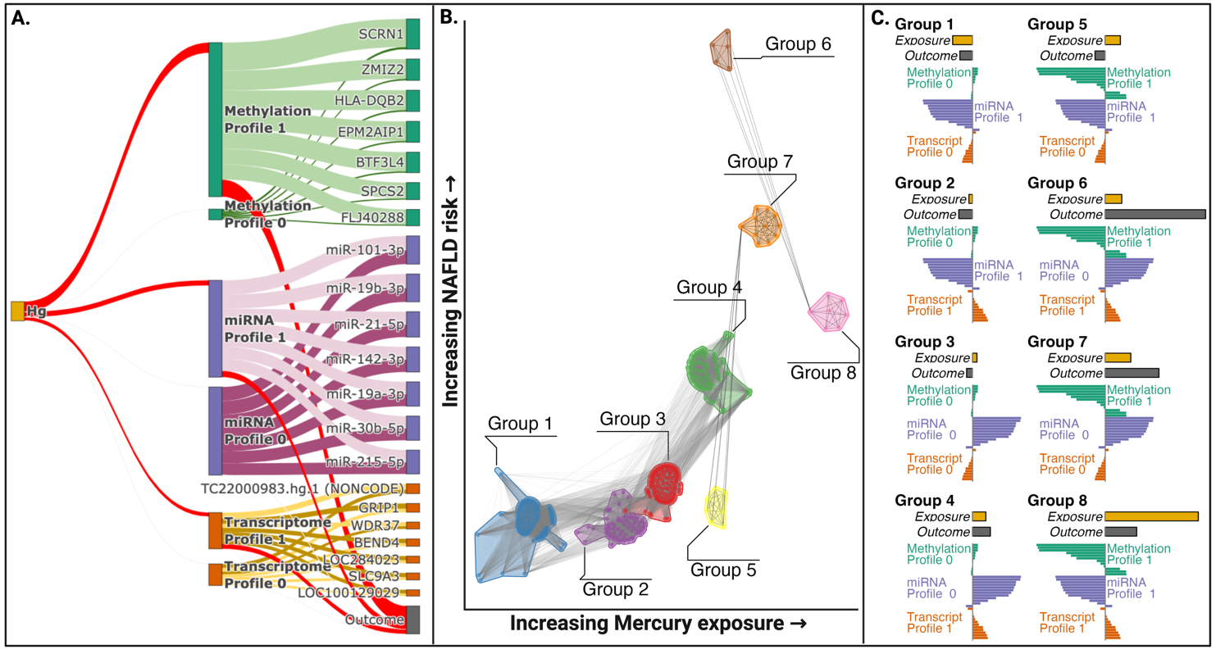
Results: Joint Analysis, Intermediate Integration
Integrated information on environmental exposures, DNA methylation, miRNA levels, and transcripts can identify groups of children at elevated risk of liver injury
Notes:
Here you really see that the epigenome is really driving some of these associations.

Slide 40
Joint Analysis, Interactions Between Omic Profiles
This assumes no interactions between profiles.
To extend this model to examine the impact of interactions between the omic profiles, we can use the probability of inclusion for each individual in each cluster, and using these values, fit a linear regression model with a three-way interaction for the outcome
This allows you to look at how all possible combinations of the omic profiles are associated with both the exposure and the outcome
Also defines omic profiles for each “group”
Number of possible groups:
K_{methlome} * K_{miRNA} * K_{transcriptome} = 2 * 2 * 2 = 8
Notes:
Here you really see that the epigenome is really driving some of these associations.

Slide 41
Joint Analysis, Interactions Between Omic Profiles
Eight groups: defined by their exposure and outcome levels
Here, each point represents an individual from our data. Lines connect individuals with similar omics profiles
Notes:
Here you really see that the epigenome is really driving some of these associations.

Slide 42
Joint Analysis, Interactions Between Omic Profiles
Notes:
Here you really see that the epigenome is really driving some of these associations.

Slide 43
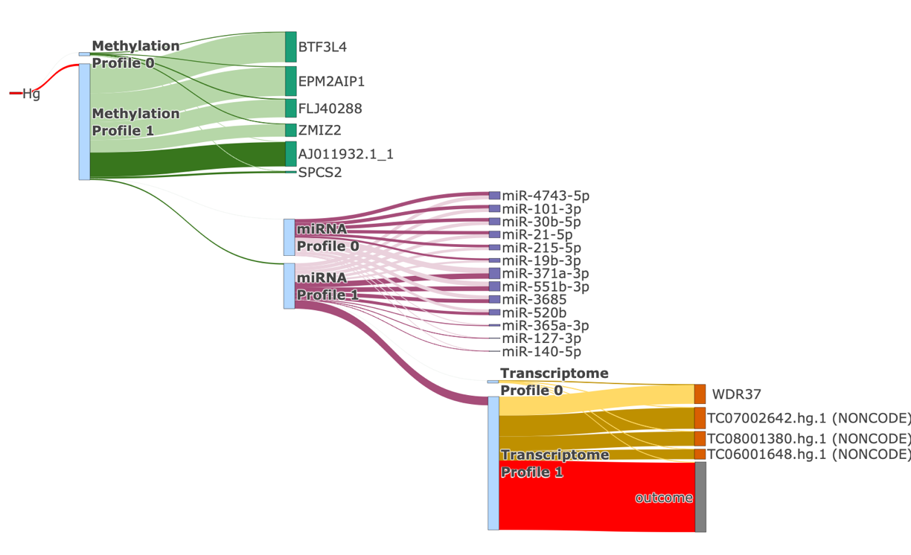
Results: LUCID, Late Integration (In Serial)

Slide 44
Different Approaches for Integration Provide Complementary Insights on Environmental Drivers of Disease
In Summary

Slide 45
Summary: modeling omics jointly vs. independently
In joint models:
Condition out highly correlated variables, and only select features that are most “important” (defined by the algorithm).
Some significant “hits” might be correlated with “causal” variables in another layer
Good for feature selection
In independent models:
Fitting mediation model on each omics layer/ omics feature separately omits the correlation structure
Select all features associated with the outcome
Good when you want to perform post hoc pathway analysis (i.e., biological interpretation)

Slide 46
Concluding Remarks
Many options for this analysis, but each tends to identify DNA methylation and gene expression as mediating factors.
Techniques specifically designed for multi-omics data work better at identifying robust multi-omics signatures (factors and/or clusters)
In practice, deciding on a data analysis approach should be driven by your research question
In reality, real data is messy and different approaches may work better or worse in practice.
You could use these methods for interaction analysis instead of mediation

Slide 47
Resources
Goodrich JA, Wang H, et al. Integrating Multi-Omics with Environmental Data for Precision Health: A Novel Analytic Framework and Case Study on Prenatal Mercury Induced Childhood Fatty Liver Disease. Preprint at SSRN.
Or: https://github.com/Goodrich-Lab

